Slide 1
Shortridge High School
Class of 1963
50 Year Reunion

Slide 2
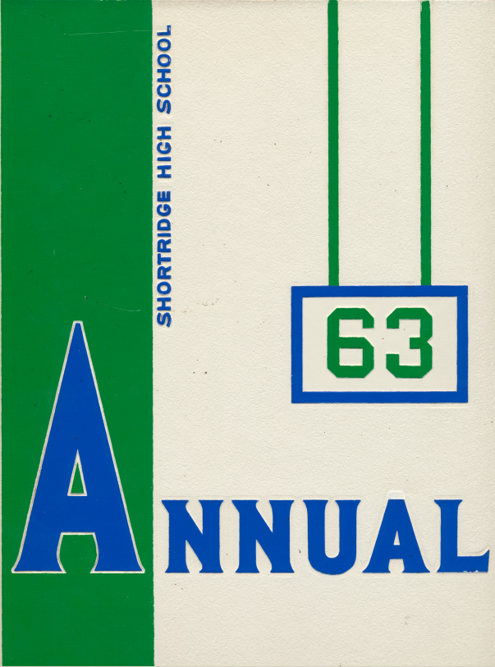
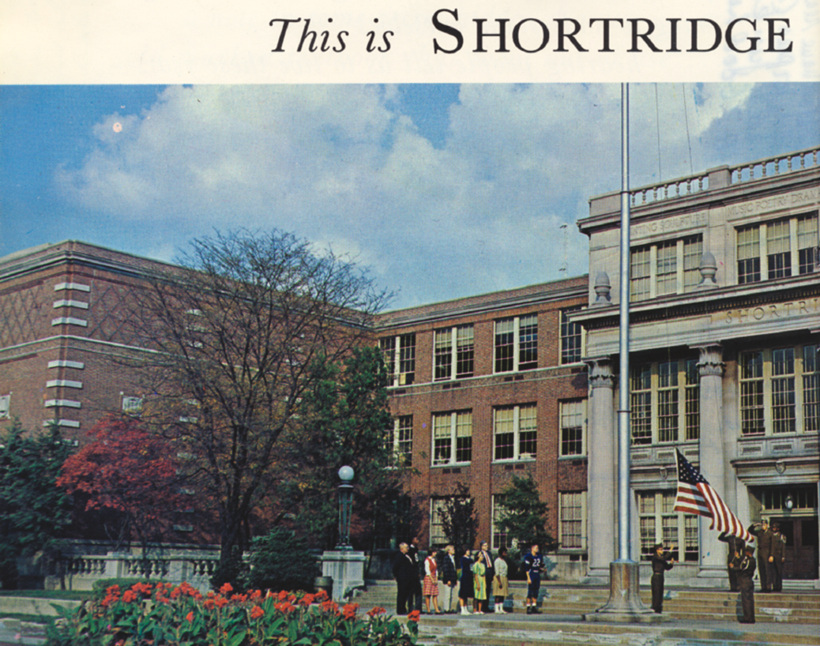

Slide 3
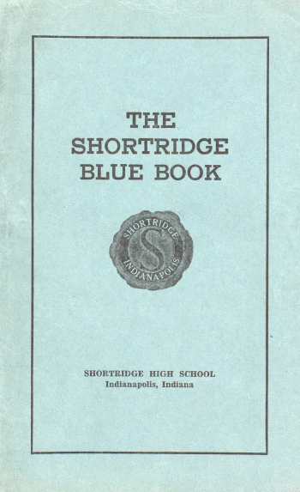
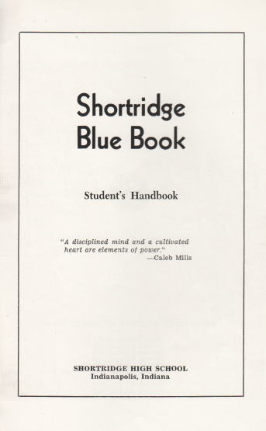
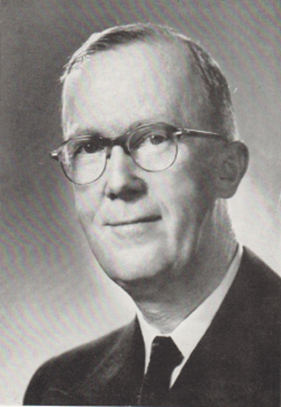

Slide 4
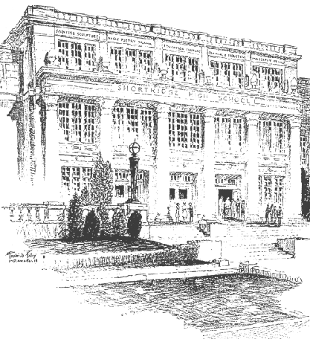

Slide 5
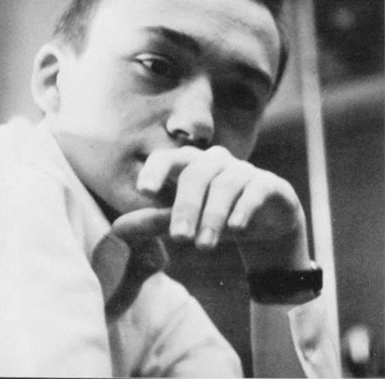
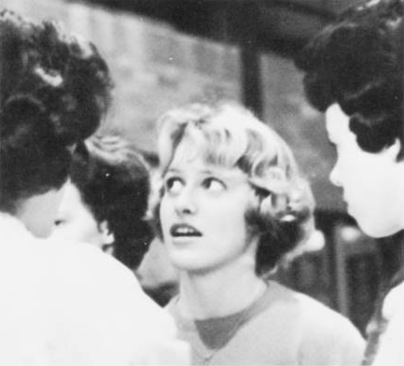
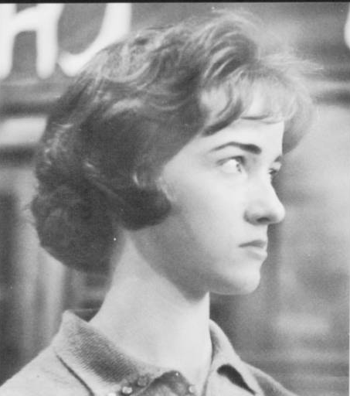
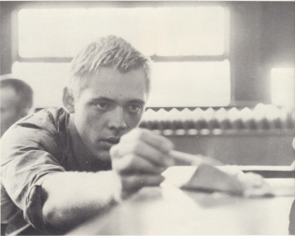

Slide 6
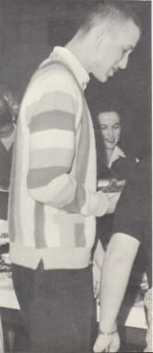
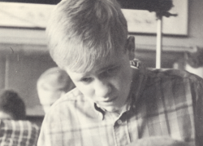
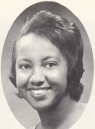
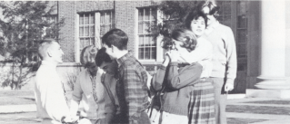
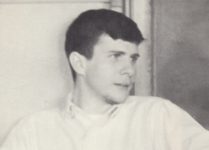

Slide 7
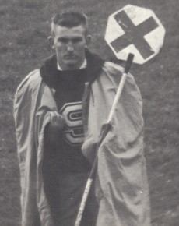
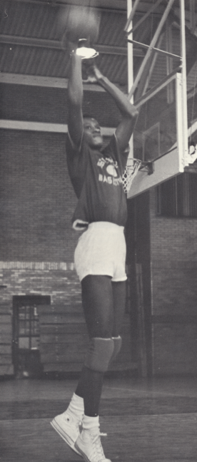
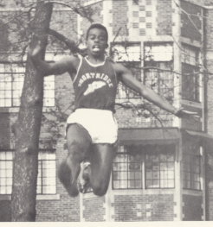
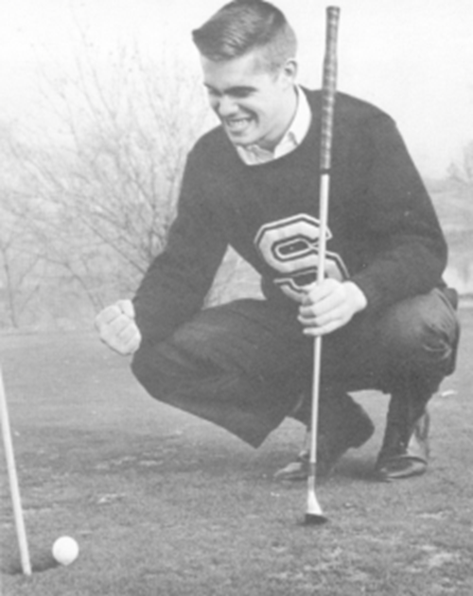

Slide 8
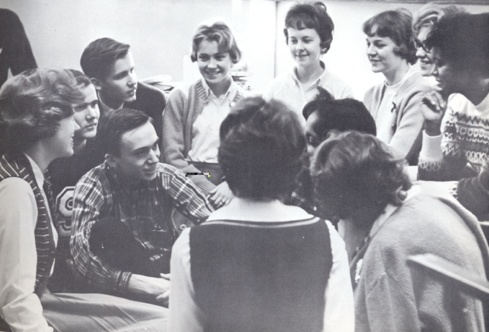
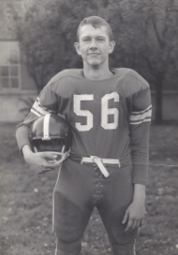
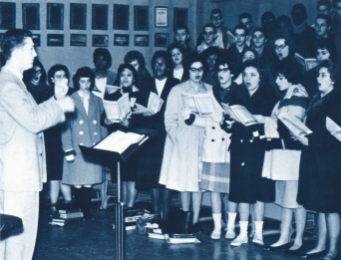
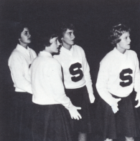

Slide 9
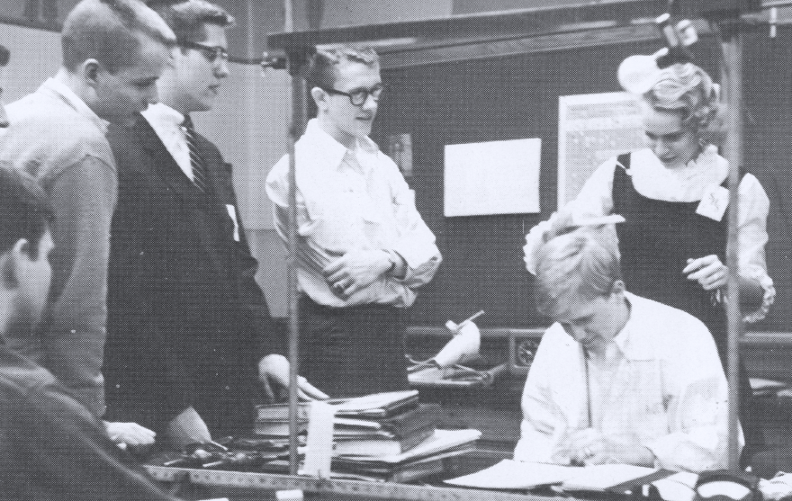
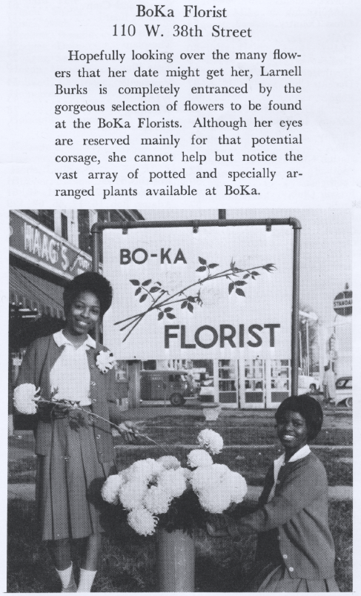
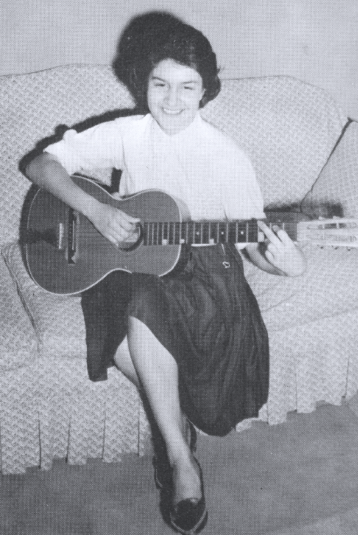
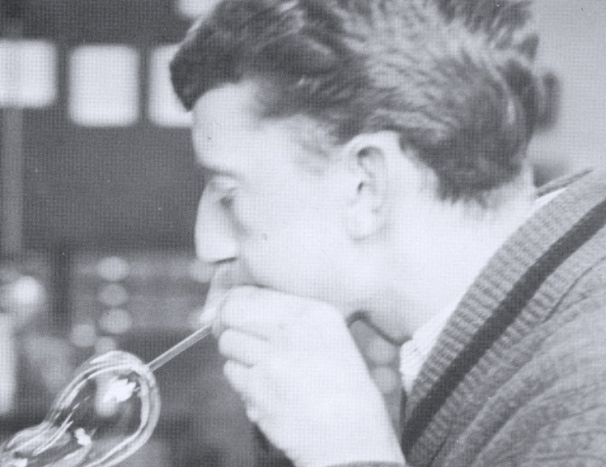

Slide 10
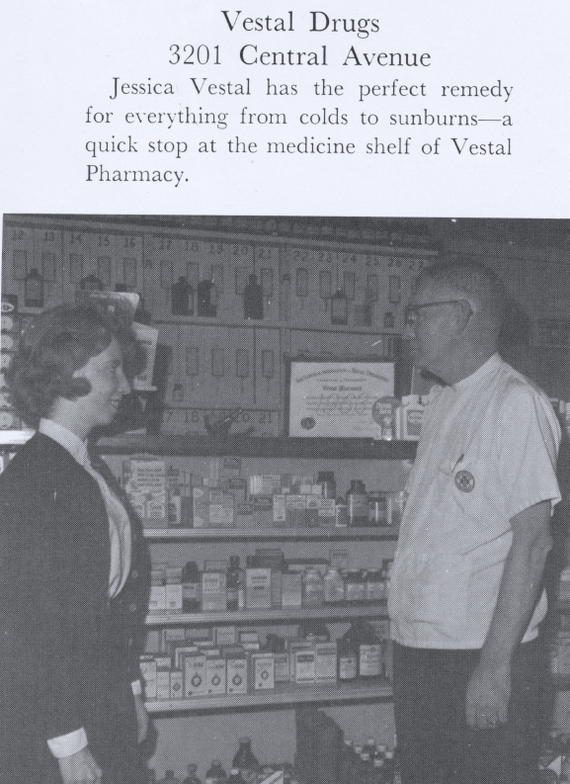
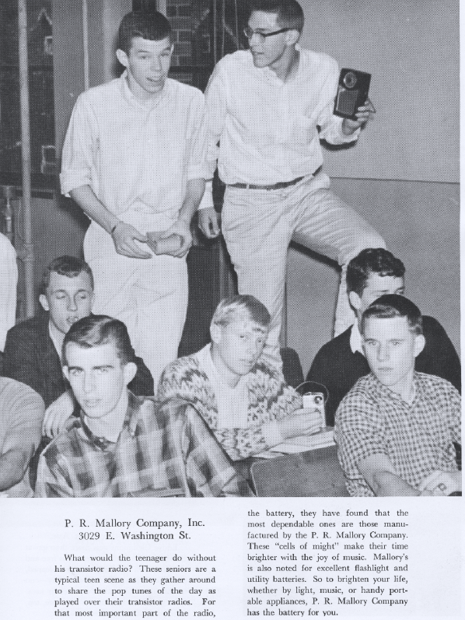
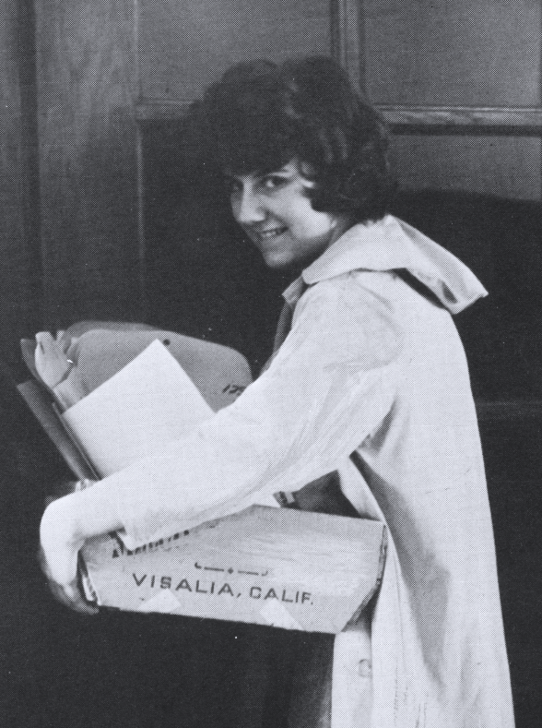

Slide 11
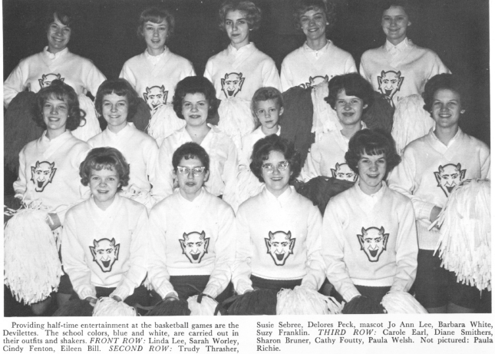

Slide 12
Remembering Grade School Days

Slide 13
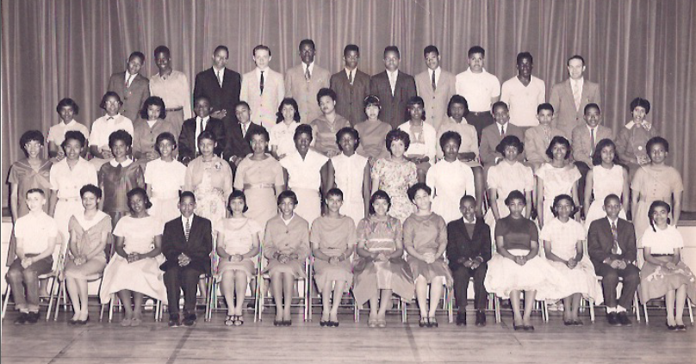
School 41, 8th Grade Picture

Slide 14
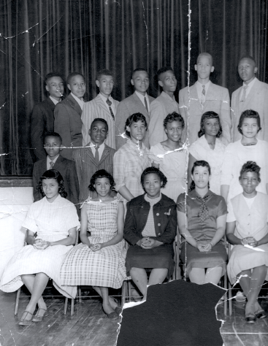
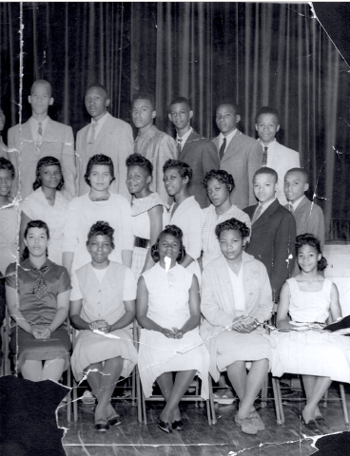
School 42, 8th Grade

Slide 15
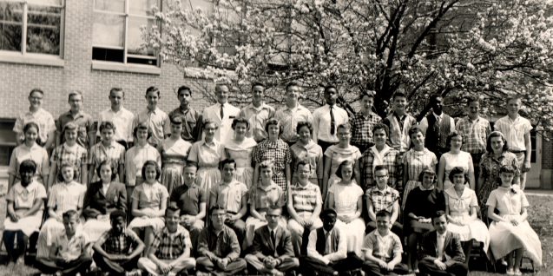
School 69, 8th Grade

Slide 16
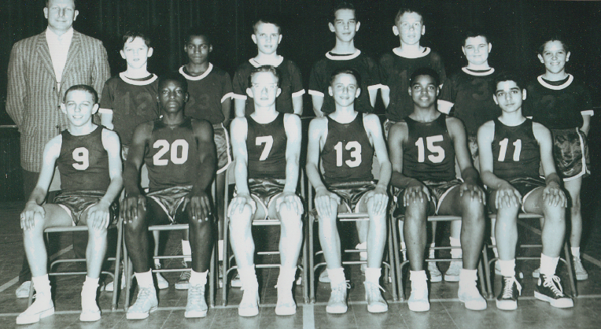
School 69 xth grade team??????

Slide 17
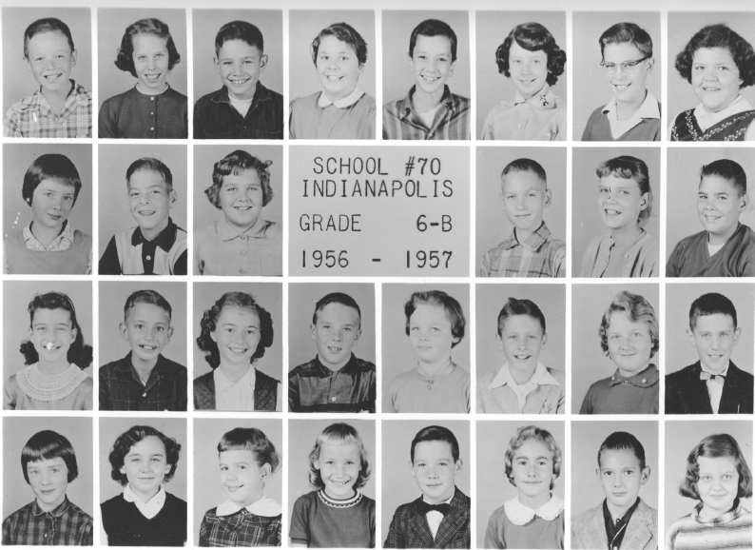

Slide 18
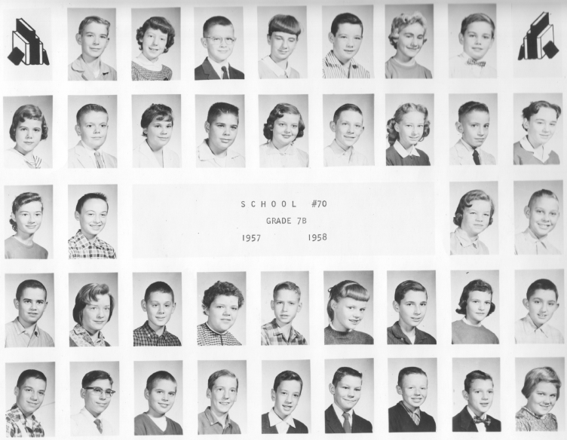

Slide 19
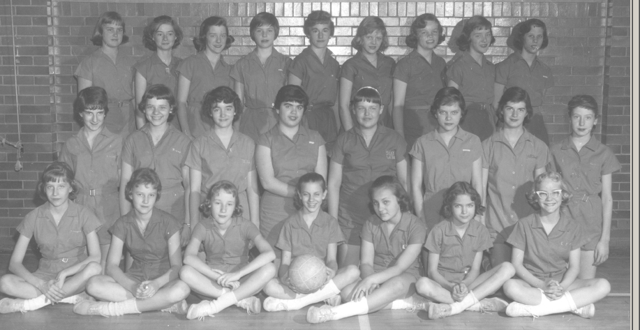
School 70, 8th Grade Volleyball

Slide 20
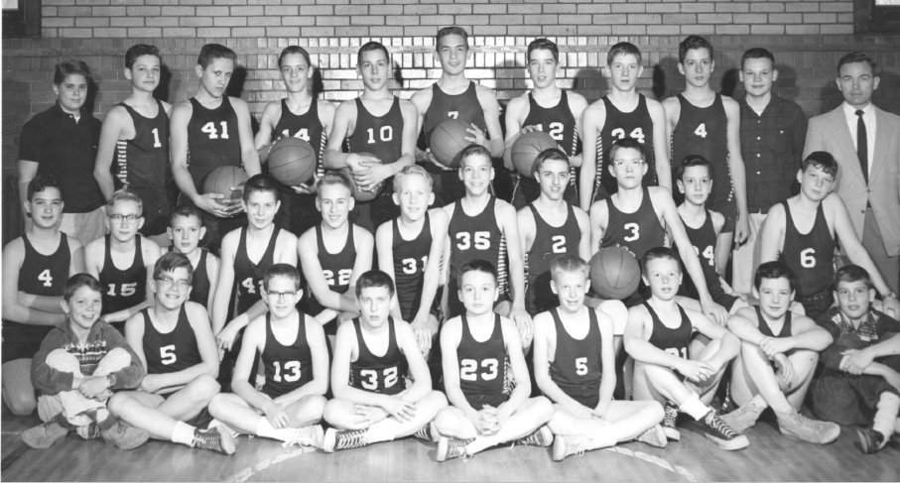
School 70, 7th Grade Basketball

Slide 21
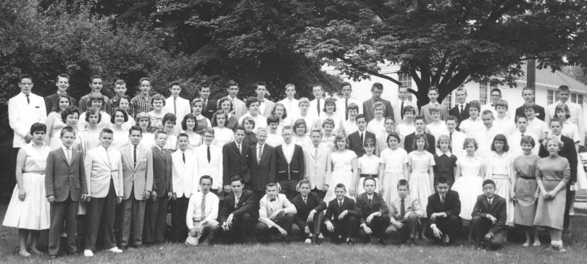
School 70, 8th Grade

Slide 22
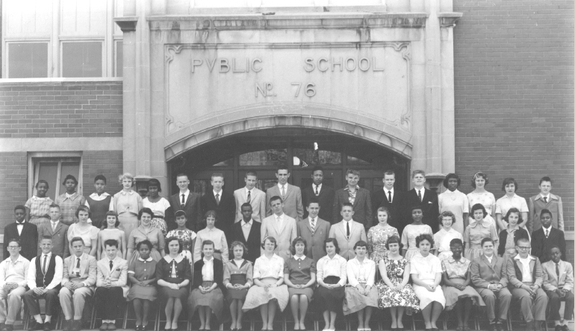
School 76, 8th Grade

Slide 23
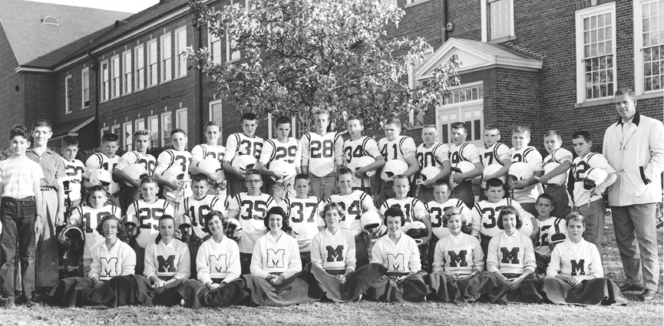
School 86 Football

Slide 24
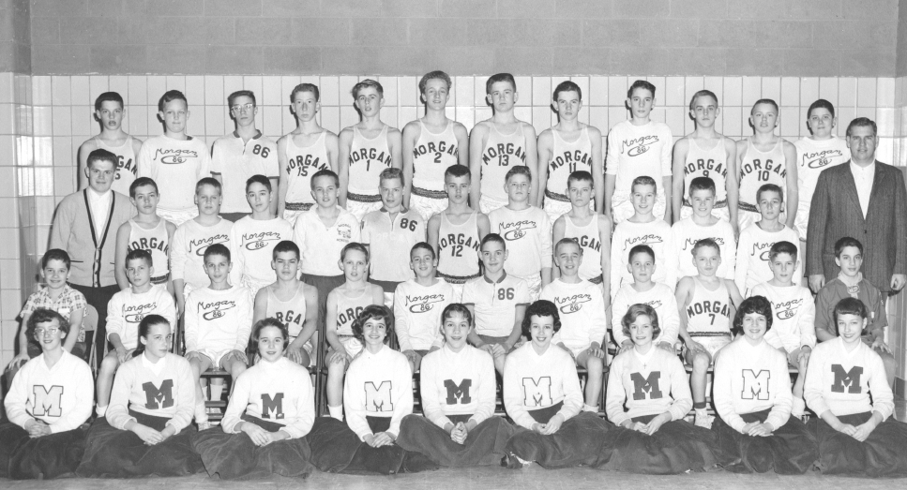
School 86 Basketball

Slide 25
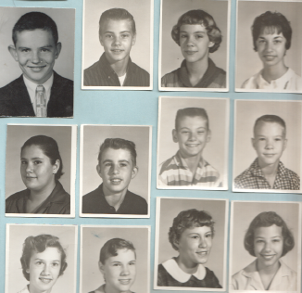
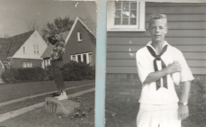
Early School 86 Pictures

Slide 26
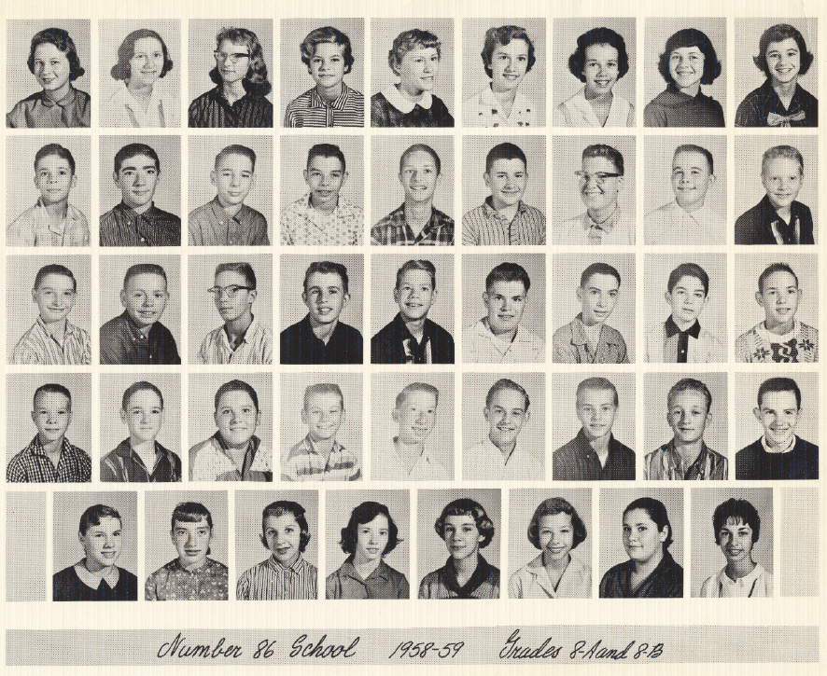

Slide 27
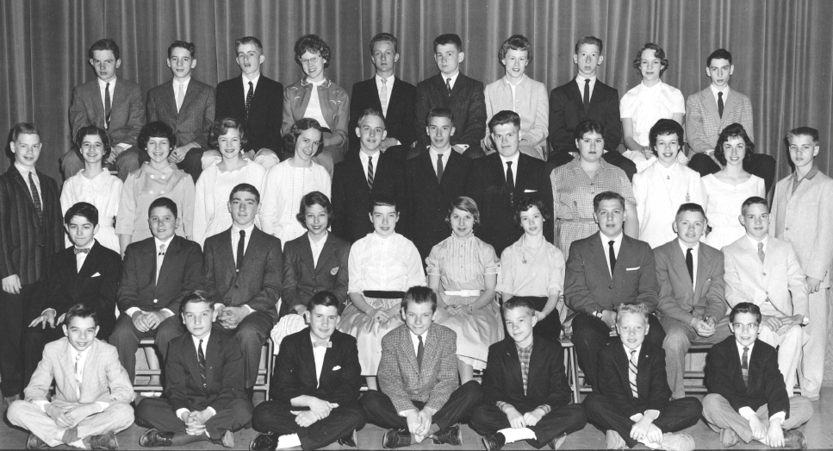
School 86, 8th Grade Graduation

Slide 28
FRESHMAN YEAR

Slide 29
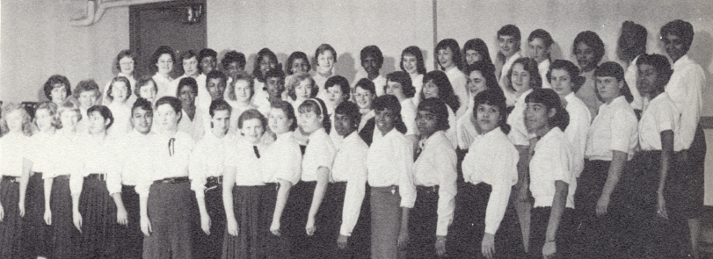
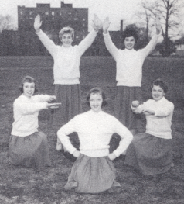

Slide 32
SOPHOMORE YEAR

Slide 40
JUNIOR YEAR

Slide 51
SENIOR YEAR

Slide 89
Past Reunion Pictures

Slide 90
35th Reunion, 1998

Slide 91
40th Reunion, 2003

Slide 93
2003 Reunion

Slide 94
45th Reunion, 2008

Slide 95
From past reunion pics, 2008

Slide 96
From past reunion pics, 2001

Slide 97
From past reunion pics, 2009

Slide 98
Did you know that a Shortridge graduate was the head writer for the I Love Lucy show and The Lucy Show?

Slide 99
And, in an episode aired on January 21, 1963¹ there are many mentions of Shortridge when Lucy’s friend, Vivian, shows Lucy her Shortridge Year Book!
Thanks to classmate Gordon West, who shared his DVD of the show, here is a short clip from that episode. Later in the show, they talk about the Blue Devils, mention Mr. Hadley, and make Shortridge a pretty key part of the show!
¹ Season 1, Episode 17, “Lucy Becomes a Reporter”

Slide 100
At start of broadcast—watch for Written by Madelyn (Pugh) Martin – Shortridge Graduate, 1938
Then enjoy the sequence where Vivian gets out her very own Shortridge yearbook!

Slide 102
Note Madelyn (Pugh) Martin as Writer

Slide 103
Check out Shortridge yearbook!

